Slide 1


Slide 2


Slide 3

How MDRT helps you members
Learn and grow your business
Expand into new products, services or markets
Master leadership and business skills

Slide 4
How MDRT helps companies
Boost productivity across your team or organization
Strengthen retenion by offering a growth path
Develop better managers and leaders

Slide 5

Key stats
$168,864 median member commission
$231,669 consecutive-year member commission
+27.3% increase in median commission for 1st year members who attended MDRT meeting
+17.6% increase in median commission for 1st year members who didn’t attend MDRT meeting

Slide 6
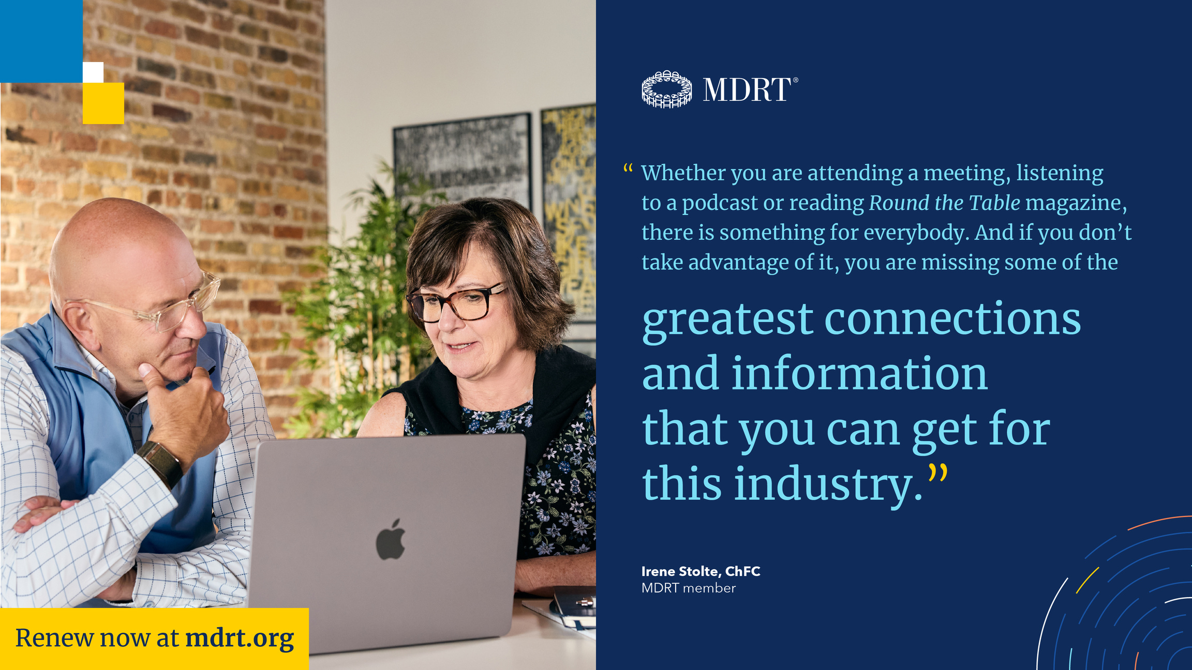

Slide 7




Benefits
Exclusive events & experiences
Dynamic, diverse network
Members-only resources
Learn more at mdrt.org/
member-benefits

Slide 8
